Slide 1

Forecasting Household Overnight Deposits with Machine Learning
Institute of AI in Management
LMU Munich

Slide 2

Motivation
M
D
M
R
C
Motivation
Data
Methods
Results
Conclusion
LMU Munich | Advanced AI
3
Notes:
Short transition slide. Say that the first part motivates the economic problem and the research gap.

Slide 3
Why forecast household overnight deposits?
Non-Maturity Deposits (NMDs)
Characteristics
Forecasting challenge
NMDs are bank liabilities without a contractual maturity: depositors can withdraw funds at any time.
Are a major source of stable and low-cost bank funding.
They matter for liquidity buffers, ALM, interest-rate-risk models, and planning.
Deposit series are persistent, non-stationary, and exposed to regime shifts in interest rates and macro-financial conditions.
Research Gap
Literature does not offer one accepted forecasting framework regarding NMDs and academic research is limited.
LMU Munich | Advanced AI
4
Notes:
Explain that the target is not an abstract time series. In banking, deposit volume forecasts influence liquidity needs and funding decisions. The difficulty is that overnight deposits have no fixed maturity and the series evolves across very different economic conditions. This motivates a benchmark that compares simple and advanced models under the same information set.

Slide 4
Research questions and contribution
Research Gap
Literature does not offer one accepted forecasting framework regarding NMDs and academic research is limited.
RQ1
RQ2
RQ3
How accurately can statistical and machine learning models forecast German household overnight deposits over a 100-day horizon?
Do nonlinear ML models outperform linear and naive benchmark models in reconstructed deposit levels?
Which covariate groups improve performance, and does this depend on the model architecture?
Contributions
Examines whether greater model complexity leads to more accurate forecasts.
Evaluates how interest-rate, macroeconomic, and financial-market covariates affect forecasting performance
Investigates whether model performance remains stable across different economic periods
LMU Munich | Advanced AI
5
Notes:
This slide connects the motivation to the research design. Be careful not to oversell ML. The research questions are deliberately comparative. The contribution is a consistent benchmark where all models are evaluated under the same rolling origins and the same realistic assumption that future macro-financial covariates are not known.

Slide 5
Data
M
D
M
R
C
Motivation
Data
Methods
Results
Conclusion
LMU Munich | Advanced AI
6
Notes:
Transition to the data section. Say that the credibility of the result depends strongly on the information set and preprocessing.

Slide 6
Data: public proxy target and macro-financial drivers
Target variable:
German household overnight deposits
Covariates
End-of-period volume
EUR billions
Public proxy for aggregate household NMD-like deposits
Sample: Jan 2003–Sep 2025
Euro Short-Term Rate
Deposit rate
German Geopolitical Risk Index
MoM inflation
DAX daily closing prices
10Y Bond
LMU Munich | Advanced AI
7
Notes:
Clarify that the project uses public household overnight deposit data rather than internal bank-level NMD data. The covariates cover interest rates, macroeconomic risk, inflation, and market conditions. The slide is also the natural place to show one clean EDA plot if you want to add it manually later.

Slide 7
Data: public proxy target and macro-financial drivers
LMU Munich | Advanced AI
7
Notes:
Clarify that the project uses public household overnight deposit data rather than internal bank-level NMD data. The covariates cover interest rates, macroeconomic risk, inflation, and market conditions. The slide is also the natural place to show one clean EDA plot if you want to add it manually later.

Slide 8
Data preprocessing
Different frequencies
Daily grid
Interpolation
First differences
LMU Munich | Advanced AI
8
Notes:
Explain preprocessing at a high level. The point is not to list every coding detail; the point is to show why the target is converted into a supervised learning problem. Models predict changes, and level forecasts are reconstructed. Also state that EDA motivates rolling-origin validation instead of a random split.

Slide 9
Methods
M
D
M
R
C
Motivation
Data
Methods
Results
Conclusion
LMU Munich | Advanced AI
9
Notes:
Transition to methods. Say that the benchmark has three parts: forecasting setup, model families, and evaluation design.

Slide 10

Forecasting setup: direct 100-step prediction
Forecasting Setup
The previous 100 daily observations form the model input.
All 100 future changes are predicted at once.
Future macro-financial covariates are not observed.
For sequence models, unknown future drivers are handled conservatively rather than leaked.
Historical window
L = 100 days
Forecast horizon
H = 100 days
t
$${\overset{ˆ}{y}}_{t+h}=y_{t}+\sum_{j=1}^{h}{{\hat{Δy}}_{t+j}}, h=1,…,100.$$
LMU Munich | Advanced AI
10
Notes:
Explain the horizontal timeline. The model sees the previous lookback window and produces a 100-step forecast. It predicts daily changes rather than levels directly; levels are reconstructed by adding predicted changes to the last observed level. This is where you should mention that the lookback length should match the final benchmark; if the final code changes it, update the label before recording.

Slide 11
Covariate design
Interest-rate drivers
Macroeconomic drivers
Financial-market drivers
Euro short-term rate
German Geopolitical Risk Index
DAX
Deposit rate
MoM inflation
10Y Bund yield
Covariate Sets
1
Full set
2
Thematic subsets
3
Single-variable tests
All six covariates together
Interest rate only
Macroeconomic only
Financial market only
All except DAX
All except inflation
Euro-short term rate only
Deposit rate only.
LMU Munich | Advanced AI
11
Notes:
This slide is for clarity. It translates code labels into report-friendly language. It also explains why the main comparison should use fixed model-specific covariate sets across all regimes. If you show regime-specific best covariates, label that as sensitivity analysis or appendix material.

Slide 12
From baseline models to deep learning
Naive Hold
Naive RW
Ridge
XGBoost
FFN
TFT
constant level
last change continues
linear + L2 shrinkage
nonlinear trees
feedforward neural net
multi-horizon transformer
LMU Munich | Advanced AI
12
Notes:
Present the model families as increasing complexity. The naive models are not weak straw men; they are relevant benchmarks for persistent financial series. Ridge is interpretable, XGBoost is nonlinear, and FFN/TFT represent neural approaches. The question is whether complexity actually pays off.

Slide 13
Evaluation: expanding-window rolling origins
2009-01-01
2013-01-01
2019-03-01
2025-06-01
Financial Crisis
Low Interest
Pre-COVID
High Interest
100-day test
100-day test
100-day test
100-day test
LMU Munich | Advanced AI
13
Notes:
Explain the rolling-origin design. At each date, training uses only past data. The four origins were chosen to represent distinct regimes. Mention that the final forecast examples should show exactly this structure: a historical window before the origin, a vertical line at the origin, and a 100-day realized comparison after it.

Slide 14
Evaluation: plots
2009-01-01
2013-01-01
2019-03-01
2025-06-01
Financial Crisis
Low Interest
Pre-COVID
High Interest
100-day test
100-day test
100-day test
100-day test
LMU Munich | Advanced AI
13
Notes:
Explain the rolling-origin design. At each date, training uses only past data. The four origins were chosen to represent distinct regimes. Mention that the final forecast examples should show exactly this structure: a historical window before the origin, a vertical line at the origin, and a 100-day realized comparison after it.

Slide 15
Results
M
D
M
R
C
Motivation
Data
Methods
Results
Conclusion
LMU Munich | Advanced AI
14
Notes:
Transition to results. The next slides answer the research questions directly: overall accuracy, stability across regimes, covariate effects, and forecast examples.

Slide 16
Primary results
Rank
Model
Best fixed set
MAE [bn €]
RMSE [bn €]
Mean R²
1
Ridge
All covariates
9.36
10.26
0.178
2
TFT
Macroeconomic
10.78
12.71
−0.361
3
Naive RW
None
11.78
14.41
−0.564
4
FFN
Macroeconomic
11.85
15.22
−0.605
5
XGBoost
Excluding inflation
12.71
14.90
−0.784
6
Naive Hold
None
17.38
21.03
−2.246
LMU Munich | Advanced AI
15
Notes:
This is the main results slide. Do not apologize for Ridge winning. Interpret it: in a highly persistent deposit series with unknown future covariates, a regularized linear model can be more stable than complex alternatives. TFT is competitive, but it does not beat Ridge on the averaged benchmark. The naive random walk is also strong, which underlines the persistence of the target.

Slide 17
Primary results
LMU Munich | Advanced AI
15
Notes:
This is the main results slide. Do not apologize for Ridge winning. Interpret it: in a highly persistent deposit series with unknown future covariates, a regularized linear model can be more stable than complex alternatives. TFT is competitive, but it does not beat Ridge on the averaged benchmark. The naive random walk is also strong, which underlines the persistence of the target.

Slide 18
Plot Summaries
LMU Munich | Advanced AI
16
Notes:
This slide visualizes the table. The heatmap shows that the 2009 origin is difficult for all models, while later periods are easier. The right panel ranks models by mean MAE with the variability across regimes. Point out that average performance and regime stability are both relevant.

Slide 19
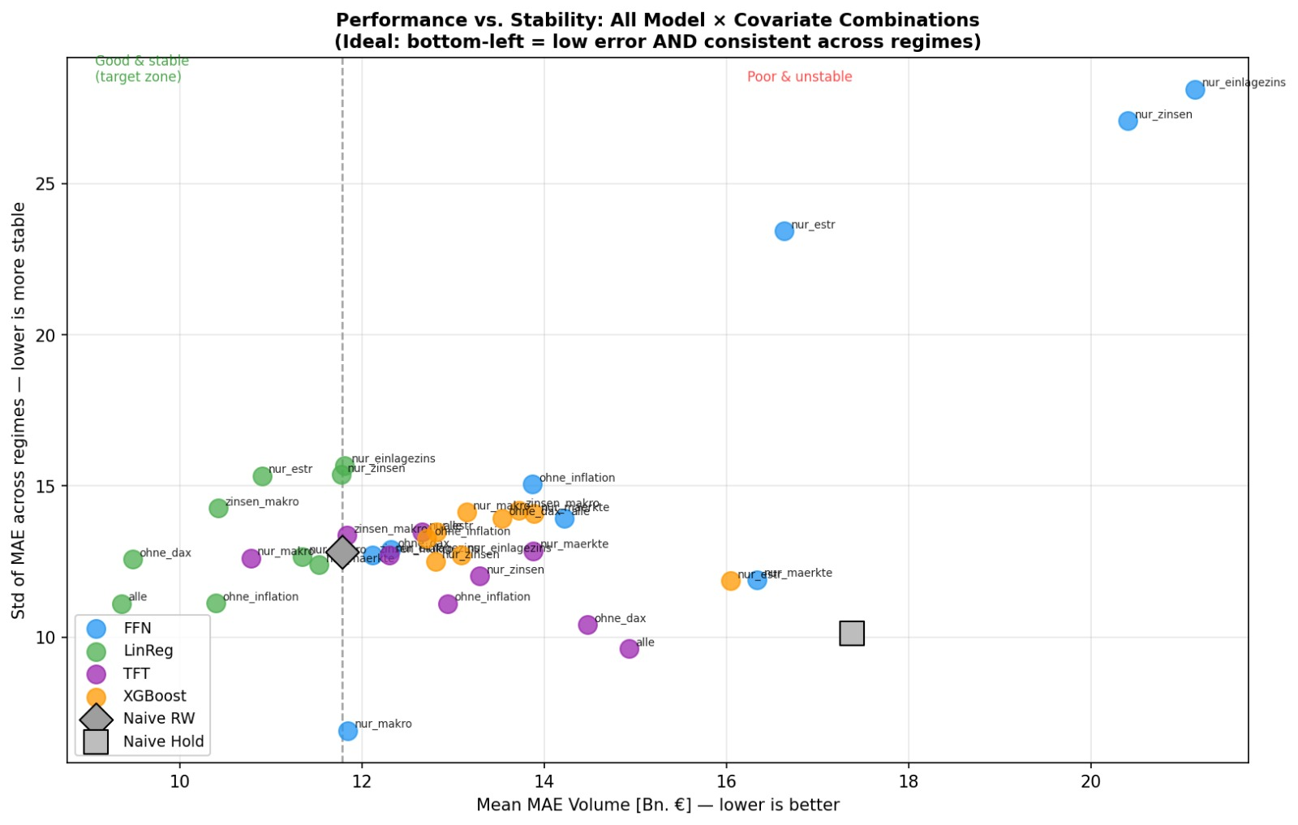
Performance vs. stability
Interpretation
Bottom-left is best: lower mean MAE and lower variation across regimes. Some specifications improve mean error but become unstable.
LMU Munich | Advanced AI
17
Notes:
Use this slide to move from ranking to robustness. A model can have a good average but be unstable across regimes. The scatter plot helps explain why the discussion should consider both level of error and standard deviation across origins.

Slide 20
Covariate effects differ by architecture
Ridge
TFT and FFN
XGBoost
Best fixed set: all covariates
Interpretation: L2 shrinkage can keep the full information set while reducing noisy coefficients.
Best fixed set: macroeconomic covariates
Interpretation: neural models benefit from a smaller, cleaner signal when data is limited and regimes change.
Best fixed set: all except inflation
Interpretation: tree models may be sensitive to unstable or regime-specific covariate behavior.
Caveat: covariate rankings are predictive, not causal. A good forecasting input is not necessarily a causal driver.
LMU Munich | Advanced AI
18
Notes:
This slide answers the covariate research question. Ridge works best with all covariates, while TFT and FFN prefer the macroeconomic set. XGBoost performs best when inflation is excluded. Say clearly that these are predictive findings. They do not prove that a variable causes deposit changes.

Slide 21
Forecast-path comparison plots to generate
Plot window: [t₀ − 100 days, t₀ + 100 forecast observations] with a vertical dashed line at t₀.
LMU Munich | Advanced AI
19
Notes:
This slide is partly an instruction slide for the final version. The recommended forecast-path figure should show one origin per regime, with the same model specifications in every panel. This avoids hindsight selection. If you add uncertainty bands, use them sparingly so the plot remains readable.

Slide 22
Discussion: why complexity did not guarantee better forecasts
High persistence
Unknown future covariates
Accumulated errors
Deposit levels move slowly; simple recent-history benchmarks are already strong.
ML models cannot exploit future rates, inflation, or market paths without scenario assumptions.
Small daily change errors compound over a 100-day reconstructed level forecast.
Extrapolation limits
Ridge advantage
Tree and neural models can struggle when the future regime differs from training patterns.
Regularization preserves useful information while avoiding overly flexible fits.
LMU Munich | Advanced AI
20
Notes:
This slide is the real discussion. Connect the empirical result to the properties of the forecasting problem. Complex models are not useless, but their advantages are limited when the target is persistent and future covariates are unavailable. This explains why Ridge can win and why TFT can still be competitive but not dominant.

Slide 23
Limitations and future work
Limitations
Future work
• Household overnight deposits are a public proxy, not internal bank-level NMD data.
• Four rolling origins are descriptive rather than statistically definitive.
• Future covariate paths are not modeled.
• Scenario-based paths for rates, inflation, and market covariates.
• Hybrid models: linear baseline plus nonlinear residual correction.
• More origins and bank-specific data for stronger validation.
LMU Munich | Advanced AI
21
Notes:
Be transparent. The study does not prove that Ridge will always win. It shows that under this public proxy, these covariates, and realistic future-information constraints, Ridge is strongest. Future work can improve the setting by adding scenario paths and more rolling origins.

Slide 24
Conclusion
Thank you

